Slide 1
Stack & Queue and Linked List
By: Amber Hayat
ahayat@ddn.upes.ac.in

Slide 2
Data Structure
In computer science, a data structure is a particular way of storing and organizing data in a computer’s memory so that it can be used efficiently.
Categories of Data Structure:
The data structure can be classified in to major types:
Linear Data Structure
Non-linear Data Structure

Slide 3
Linear Data Structure:
A data structure is said to be linear if its elements form any sequence.
There are basically two ways of representing such linear structure in memory.
The common examples of linear data structure are
Arrays
Queues
Stacks
Linked lists

Slide 4
Non-linear Data Structure:
This structure is mainly used to represent data containing a hierarchical relationship between elements.
e.g. graphs, trees

Slide 5
Data Structures Operations
Traversing: accessing each record/node exactly once so that certain items in the record may be processed. (This accessing and processing is sometimes
called “visiting” the record.)
Searching: Finding the location of the desired node with a given key value,or finding the locations of all such nodes which satisfy one or more conditions.
Inserting: Adding a new node/record to the structure.
Deleting: Removing a node/record from the structure.

Slide 6
Stack-Introduction
Stack is a LIFO (last in first out) structure.
It is an ordered list of the same type of elements.
A stack is a linear list where all insertions and deletions are permitted only at one end of the list.
When elements are added to stack it grow at one end.
Similarly, when elements are deleted from a stack, it shrinks at the same end.

Slide 7
Basic features of Stack
push() function is used to insert new elements into the Stack and pop() is used to delete an element from the stack. Both insertion and deletion are allowed at only one end of Stack called Top.
Stack is said to be in Overflow state when it is completely full and is said to be in Underflow state if it is completely empty

Slide 8
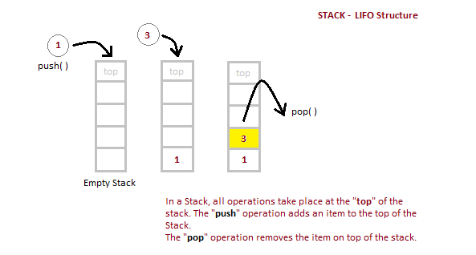
Example

Slide 9
Algorithm for PUSH operation
begin procedure push: stack, data
if stack is full
return null
end
top ← top + 1
stack[top] ← data
end procedure

Slide 10
Algorithm for POP operation
begin procedure pop: stack
if stack is empty
return null
endif
data ← stack[top]
top ← top - 1
return data
end procedure

Slide 11
Array Representation of Stack
#include<stdio.h>
#include<conio.h>
#include<process.h> //for exit()
#define MAX 5 //Maximum number of elements that can be stored
int top=-1,stack[MAX];
void push();
void pop();
void display();

Slide 12
void main()
{
int ch;
while(1) //infinite loop, will end when
choice will be 4
{
printf(“*** Stack Menu ***”);
printf(“\n1.Push\n2.Pop\n3.Display\n4.Exit”);
printf(“nnEnter your
choice(1-4):”);
scanf(“%d”,&ch);

Slide 13
scanf(“%d”,&ch);
switch(ch)
{
case 1: push();
break;
case 2: pop();
break;
case 3: display();
break;
case 4: exit(0);
default: printf(“nWrong
Choice!!Press any key….”);
getch();
}
}
}

Slide 14
void push()
{
int val;
if(top==MAX-1)
{
printf(“nStack is full!!Press any
key….”);
getch();
}
else
{
printf(“nEnter element to
push:”);
scanf(“%d”,&val);
top=top+1;
stack[top]=val;
printf(“nPress any
key….”);
getch();
}
}

Slide 15
void pop()
{
if(top==-1)
{
printf(“nStack is empty!!Press any key….”);
getch();
}
else
{
printf(“nDeleted element is %dnPress any key….”,stack[top]);
top=top-1;
getch();
}
}
void display()

Slide 16
{
int i;
if(top==-1)
{
printf(“nStack is empty!!Press any key….”);
getch();
}
else
{
printf(“nStack is…n”);
for(i=top;i>=0;–i)
printf(“%dn”,stack[i]);
printf(“nPress any key….”);
getch();
}
}

Slide 17
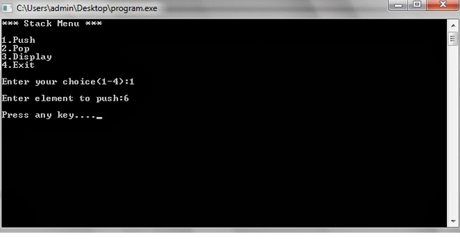
Output

Slide 18
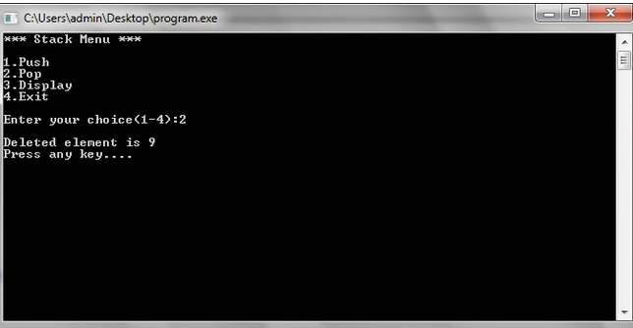

Slide 19
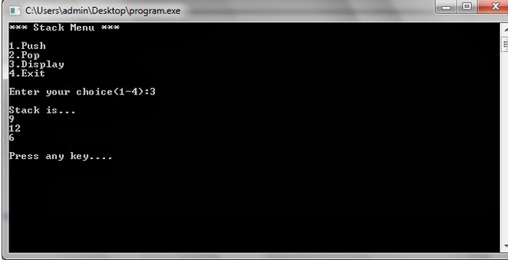

Slide 20
Applications of Stack
Recursive Function
Expression Evaluation
Expression Conversion
Infix to Postfix
Infix to Prefix
Postfix to Infix
Prefix to Infix
Towers of hanoi

Slide 21
Queue
Queue,is a data structure similar to stack with some differences.
queue is opened at both end.
One end is always used to insert data (enqueue) and the other is used to remove data (dequeue).
Queue follows First-In-First-Out methodology, i.e., the data item stored first will be accessed first.

Slide 22
A real world example of queue can be a single-lane one-way road, where the vehicle enters first, exits first. More real-world example can be seen as queues at ticket windows & bus-stops.

Slide 23
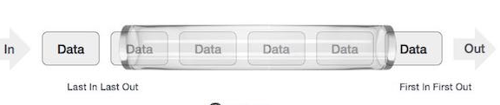
Queue Representation

Slide 24
Basic Operations
Queue operations may involve initializing or defining the queue, utilizing it and then completing erasing it from memory. Here we shall try to understand basic operations associated with queues −
enqueue() − add (store) an item to the queue.
dequeue() − remove (access) an item from the queue.

Slide 25
Enqueue Operation
A queue maintains two data pointers, front and rear.
The following steps should be taken to enqueue (insert) data into a queue −
Step 1 − Check if queue is full.
Step 2 − If queue is full, produce overflow error and exit.
Step 3 − If queue is not full, increment rear pointer to point next empty space.
Step 4 − Add data element to the queue location, where rear is pointing.
Step 5 − return success.

Slide 26
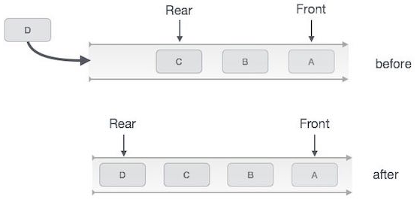

Slide 27
Algorithm for enqueue operation
procedure enqueue(data)
if queue is full
return overflow
endif
rear ← rear + 1
queue[rear] ← data
return true
end procedure

Slide 28
Dequeue Operation
Accessing data from queue is a process of two tasks − access the data where front is pointing and remove the data after access. The following steps are taken to perform dequeue operation −
Step 1 − Check if queue is empty.
Step 2 − If queue is empty, produce underflow error and exit.
Step 3 − If queue is not empty, access data where front is pointing.
Step 3 − Increment front pointer to point next available data element.
Step 5 − return success.

Slide 29
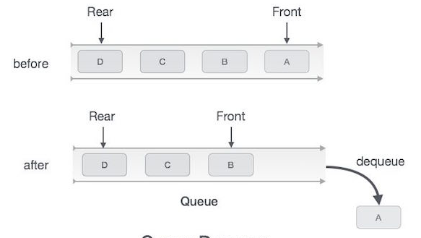

Slide 30
Representing Queues using Arrays
/*
* C Program to Implement a Queue using an Array
*/
#include <stdio.h>
#define MAX 50
int queue_array[MAX];
int rear = - 1;
int front = - 1;

Slide 31
main()
{
int choice;
while (1)
{
printf("1.Insert element to queue \n");
printf("2.Delete element from queue \n");
printf("3.Display all elements of queue \n");
printf("4.Quit \n");
printf("Enter your choice : ");
scanf("%d", &choice);

Slide 32
switch (choice)
{
case 1:
insert();
break;
case 2:
delete();
break;

Slide 33
case 3:
display();
break;
case 4:
exit(1);
default:
printf("Wrong choice \n");
} /*End of switch*/
} /*End of while*/
} /*End of main()*/

Slide 34
insert()
{
int add_item;
if (rear == MAX - 1)
printf("Queue Overflow \n");
else
{
if (front == - 1)
/*If queue is initially empty */
front = 0;
printf("Inset the element in queue : ");
scanf("%d", &add_item);
rear = rear + 1;

Slide 35
queue_array[rear] = add_item;
}
} /*End of insert()*/

Slide 36
delete()
{
if (front == - 1 || front > rear)
{
printf("Queue Underflow \n");
return ;
}

Slide 37
else
{
printf("Element deleted from queue is : %d\n", queue_array[front]);
front = front + 1;
}
} /*End of delete() */

Slide 38
display()
{
int i;
if (front == - 1)
printf("Queue is empty \n");
else
{
printf("Queue is : \n");
for (i = front; i <= rear; i++)
printf("%d ", queue_array[i]);
printf("\n");
}

Slide 39
Output
1.Insert element to queue
2.Delete element from queue
3.Display all elements of queue
4.Quit
Enter your choice : 1
Inset the element in queue : 10
1.Insert element to queue
2.Delete element from queue
3.Display all elements of queue
4.Quit
Enter your choice : 1
Inset the element in queue : 15
1.Insert element to queue
2.Delete element from queue
3.Display all elements of queue
4.Quit
Enter your choice : 1
Inset the element in queue : 20
1.Insert element to queue
2.Delete element from queue
3.Display all elements of queue
4.Quit

Slide 40
Enter your choice : 1
Inset the element in queue : 30
1.Insert element to queue
2.Delete element from queue
3.Display all elements of queue
4.Quit
Enter your choice : 2
Element deleted from queue is : 10
1.Insert element to queue
2.Delete element from queue
3.Display all elements of queue
4.Quit
Enter your choice : 3
Queue is :
15 20 30
1.Insert element to queue
2.Delete element from queue
3.Display all elements of queue
4.Quit
Enter your choice : 4

Slide 41
Notations
The way to write arithmetic expression is known as notation. An arithmetic expression can be written in three different but equivalent notations, i.e., without changing the essence or output of expression. These notations are −
Infix Notation
Prefix (Polish) Notation
Postfix (Reverse-Polish) Notation

Slide 42
Infix Notation
We write expression in infix notation, e.g. a-b+c, where operators are used in-between operands.

Slide 43
Prefix Notation/Polish Notation
In this notation, operator is prefixed to operands, i.e. operator is written ahead of operands. For example +ab. This is equivalent to its infix notation a+b. Prefix notation is also known as Polish Notation.

Slide 44
Postfix Notation/Reversed Polish Notation
This notation style is known as Reversed Polish Notation. In this notation style, operator is postfixed to the operands i.e., operator is written after the operands. For example ab+. This is equivalent to its infix notation a+b.

Slide 45
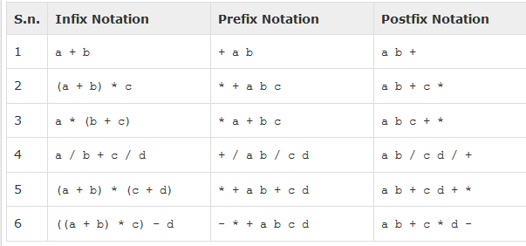

Slide 46
Associativity
Associativity describes the rule where operators with same precedence appear in an expression. For example, in expression a+b−c, both + and − has same precedence, then which part of expression will be evaluated first, is determined by associativity of those operators. Here, both + and − are left associative, so the expression will be evaluated as (a+b)−c

Slide 47
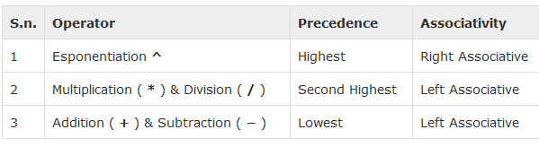
Precedence and associativity, determines the order of evaluation of an expression. An operator precedence and associativity table is given below (highest to lowest) −

Slide 48
In a+b*c, the expression part b*c will be evaluated first, as multiplication as precedence over addition. We here use parenthesis to make a+b be evaluated first, like (a+b)*c.

Slide 49
Infix to Postfix
The following algorithm transform the infix expression Q into its equivalent postfix expression P.
It uses a stack to temporary hold the operators and left parenthesis.
The postfix expression will be constructed from left to right using operands from Q and operators popped from STACK.

Slide 50
Algorithm: Infix_to_PostFix(Q, P)
Suppose Q is an arithmetic expression written in infix notation. This
algorithm finds the equivalent postfix expression P.
1. Push “(“ onto STACK, and add “)” to the end of Q.
2. Scan Q from left to right and repeat Steps 3 to 6 for each element of Q until the STACK is empty:
3. If an operand is encountered, add it to P.
4. If a left parenthesis is encountered, push it onto STACK.
5. If an operator © is encountered, then:
a) Repeatedly pop from STACK and add to P each operator
(on the top of STACK) which has the same or higher precedence/priority than ©
b) Add © to STACK.
[End of If structure.]

Slide 51
If a right parenthesis is encountered, then:
a) Repeatedly pop from STACK and add to P each operator (on the top of STACK) until a left parenthesis is encountered.
b) Remove the left parenthesis. [Do not add the left parenthesis to P.]
[End of If structure.]
[End of Step 2 loop.]
Exit.

Slide 52
Convert Q: A+( B * C – ( D / E ^ F ) * G ) * H into postfix form showing stack status .
Now add “)” at the end of expression A+( B * C – ( D / E ^ F ) * G ) * H ) and also Push a “(“ on Stack.

Slide 53
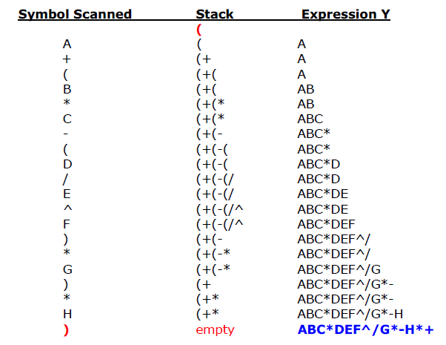

Slide 54
Evaluation of Postfix Expression
If P is an arithmetic expression written in postfix notation. This algorithm uses STACK to hold operands, and evaluate P.

Slide 55
Algorithm: This algorithm finds the VALUE of P written in postfix notation.
1. Add a Dollar Sign ”$” at the end of P. [This acts as sentinel.]
2. Scan P from left to right and repeat Steps 3 and 4 for each element of P
until the sentinel “$” is encountered.
3. If an operand is encountered, put it on STACK.
4. If an operator © is encountered, then:
a) Remove the two top elements of STACK, where A is the top
element and B is the next-to—top-element.
b) Evaluate B © A.
c) Place the result of (b) back on STACK.
[End of If structure.]
[End of Step 2 loop.]
5. Set VALUE equal to the top element on STACK.
6. Exit.

Slide 56
example
Following is an infix arithmetic expression
(5 + 2) * 3 – 9 / 3
And its postfix is:
5 2 + 3 * 9 3 / –
Now add “$” at the end of expression as a sentinel.
5 2 + 3 * 8 4 / – $

Slide 57
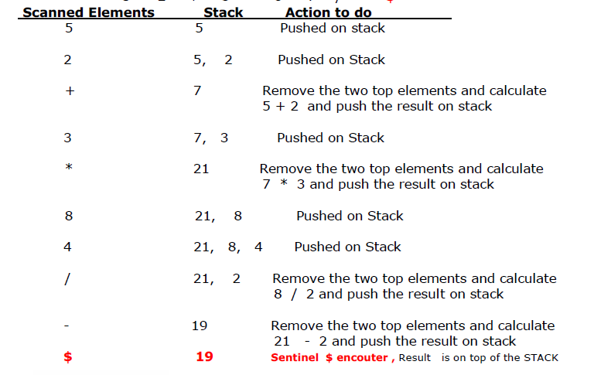

Slide 58
Linked List
Linked List is a linear data structure and it is very common data structure which consists of group of nodes in a sequence which is divided in two parts.
Each node consists of its own data and the address of the next node and forms a chain. Linked Lists are used to create trees and graphs.

Slide 59
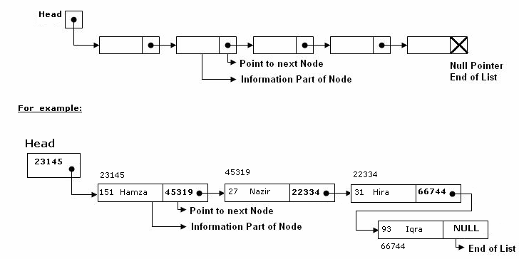
Linked List

Slide 60
The Head is a special pointer variable which contains the address of the first node of the list.
If there is no node available in the list then Head contains NULL value that means, List is empty.
The left part of the each node represents the information part of the node, which may contain an entire record of data.
The right part represents pointer/link to the next node.
The next pointer of the last node is null pointer signal the end of the list.

Slide 61
Advantages of Linked Lists
They are a dynamic in nature which allocates the memory when required.
Insertion and deletion operations can be easily implemented.
Stacks and queues can be easily executed.
Linked List reduces the access time.

Slide 62
Disadvantages of Linked Lists
The memory is wasted as pointers require extra memory for storage.
No element can be accessed randomly; it has to access each node sequentially.
Reverse Traversing is difficult in linked list.

Slide 63
Applications of Linked Lists
Linked lists are used to implement stacks, queues, graphs, etc.
Linked lists let you insert elements at the beginning and end of the list.
In Linked Lists we don’t need to know the size in advance.

Slide 64
Types of Linked Lists
Singly Linked List : Singly linked lists contain nodes which have a data part as well as an address part i.e. next, which points to the next node in sequence of nodes. The operations we can perform on singly linked lists are insertion, deletion and traversal.

Slide 65
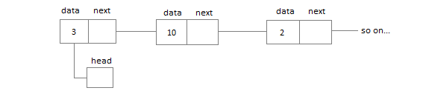

Slide 66
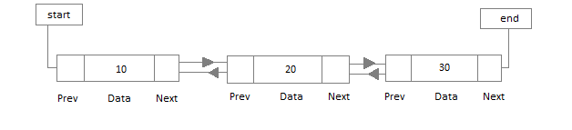
Doubly Linked List
Doubly Linked List : In a doubly linked list, each node contains two links the first link points to the previous node and the next link points to the next node in the sequence.

Slide 67
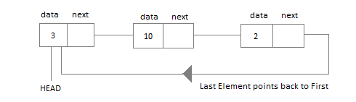
Circular Linked List
Circular Linked List : In the circular linked list the last node of the list contains the address of the first node and forms a circular chain.

Slide 68
Operations on Linked List
Traversing a Linked List
Searching a Linked List:

Slide 69
Traversing a Linked List
Suppose we want to traverse LIST in order to process each node exactly once.
The traversing algorithm uses a pointer variable PTR which points to the node that is currently being processed.
Accordingly, PTR->NEXT points to the next node to be processed so,
PTR=HEAD [ Moves the pointer to the first node of the list]
PTR=PTR->NEXT [ Moves the pointer to the next node in the list.]

Slide 70
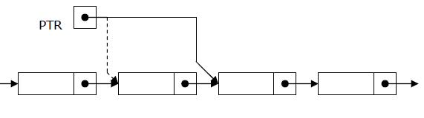

Slide 71
Algorithm for traversing a linked list
Algorithm: (Traversing a Linked List) Let LIST be a linked list in memory. This algorithm traverses LIST, applying an operation PROCESS to each element of list. The variable PTR point to the node currently being processed.
1. Set PTR=HEAD. [Initializes pointer PTR.]
2. Repeat Steps 3 and 4 while PTR!=NULL.
3. Apply PROCESS to PTR-> INFO.
4. Set PTR= PTR-> NEXT [PTR now points to the next node.]
[End of Step 2 loop.]
5. Exit.

Slide 72
Searching a Linked List
Let list be a linked list in the memory and a specific ITEM of information is given to search.
If ITEM is actually a key value and we are searching through a LIST for the record containing ITEM, then ITEM can appear only once in the LIST.
Search for wanted ITEM in List can be performed by traversing the list using a pointer variable PTR and comparing ITEM with the contents PTR->INFO of each node, one by one of list.

Slide 73
Algorithm for searching in linked list
Algorithm: SEARCH(INFO, NEXT, HEAD, ITEM, PREV, CURR, SCAN)
LIST is a linked list in the memory. This algorithm finds the location
LOC of the node where ITEM first appear in LIST, otherwise sets LOC=NULL.
1. Set PTR=HEAD.
2. Repeat Step 3 and 4 while PTR≠NULL:
3. if ITEM = PTR->INFO then:
Set LOC=PTR, and return. [Search is successful.]
[End of If structure.]
4. Set PTR=PTR->NEXT
[End of Step 2 loop.]
5. Set LOC=NULL, and return. [Search is unsuccessful.]
6. Exit.

Slide 74
Search Linked List for insertion and deletion of Nodes
Search Linked List for insertion and deletion of Nodes:
Both insertion and deletion operations need searching the linked list.
To add a new node, we must identify the logical predecessor (address of previous node) where the new node is to be inserting.
To delete a node, we must identify the location (addresses) of the node to be deleted and its logical predecessor (previous node).

Slide 75
Basic Search Concept
Assume there is a sorted linked list and we wish that after each insertion/deletion this list should always be sorted.
Given a target value, the search attempts to locate the requested node in the linked list.
Since nodes in a linked list have no names, we use two pointers, pre (for previous) and cur (for current) nodes.
At the beginning of the search, the pre pointer is null and the cur pointer points to the first node (Head).
The search algorithm moves the two pointers together towards the end of the list.
Following Figure shows the movement of these two pointers through the list in an extreme case scenario: whenthe target value is larger than any value in the list.

Slide 76
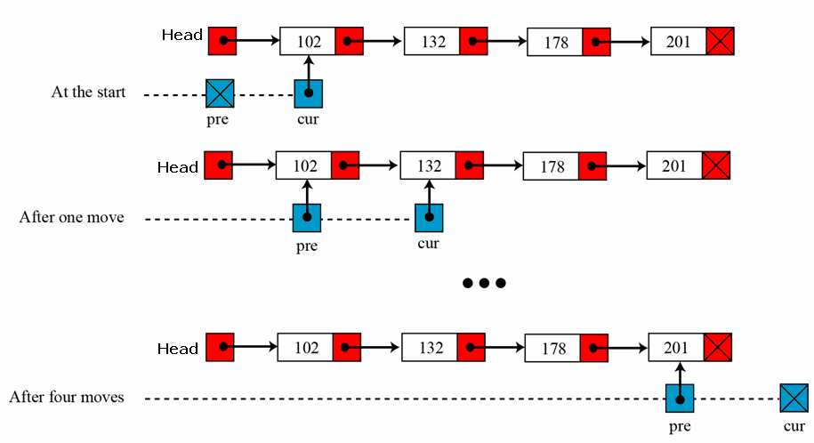
Moving of pre and cur pointers in searching a linked list

Slide 77
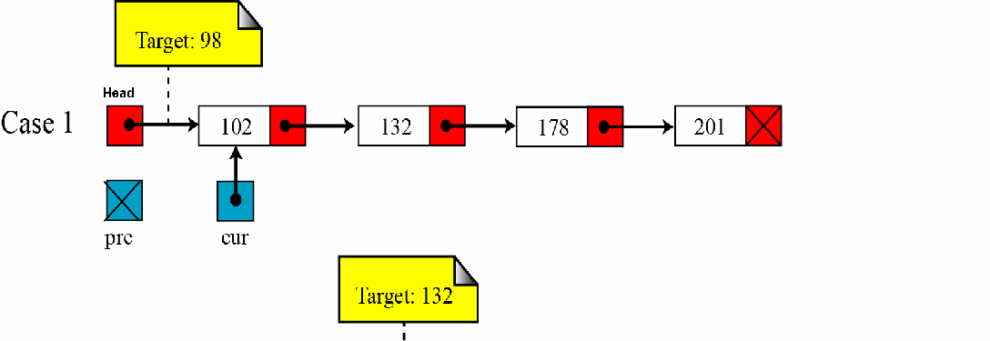
Values of pre and cur pointers in different cases

Slide 78
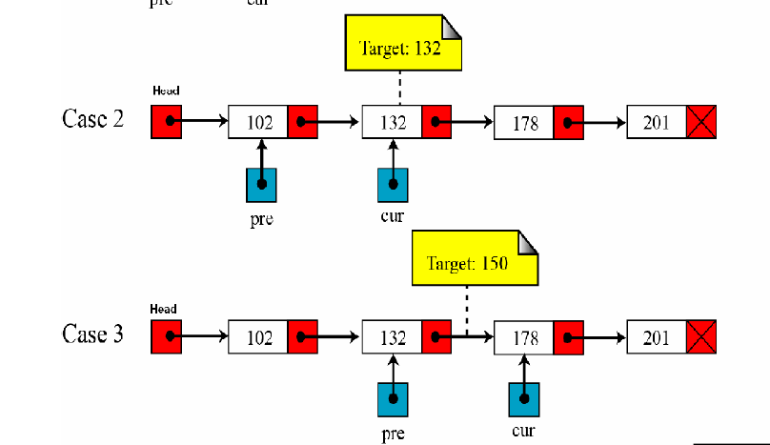

Slide 79
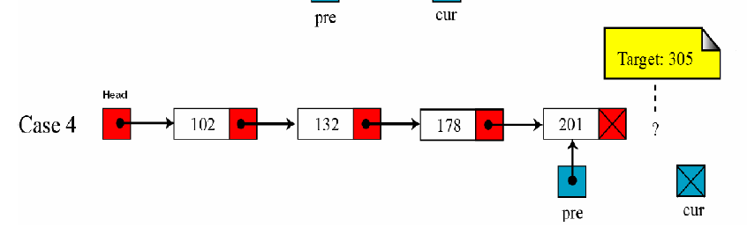

Slide 80
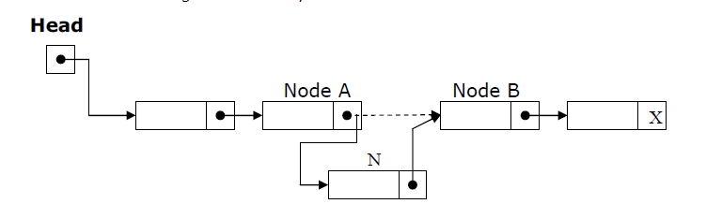
Insertion into a Linked List:
If a node N is to be inserted into the list between nodes A and B in a linked list named LIST.
Its schematic diagram would be;

Slide 81
Inserting at the Beginning of a List
If the linked list is sorted list and new node has the least low value already stored in the list i.e. (if New->info < Head->info) then new node is inserted at the beginning / Top of the list.

Slide 82
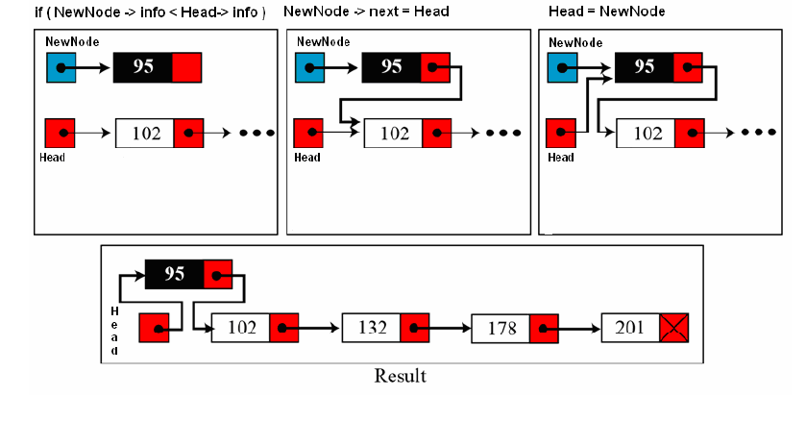

Slide 83
Inserting a new node in list
Algorithm: INSERT( ITEM)
[This algorithm add newnodes at any position (Top, in Middle and at End) in the List ]
1. Create a NewNode node in memory
2. Set NewNode -> INFO =ITEM. [Copies new data into INFO of new node.]
3. Set NewNode -> NEXT = NULL. [Copies NULL in NEXT of new node.]
4. If HEAD=NULL, then HEAD=NewNode and return. [Add first node in list]
5. if NewNode-> INFO < HEAD->INFO then Set NewNode->NEXT=HEAD and HEAD=NewNode and return
[Add node on top of existing list]
6. PrevNode = NULL, CurrNode=NULL;
7. for(CurrNode =HEAD; CurrNode != NULL; CurrNode = CurrNode ->NEXT)
{ if(NewNode->INFO <= CurrNode ->INFO)
{
break the loop
}
PrevNode = CurrNode;
} [ end of loop ]
[Insert after PREV node (in middle or at end) of the list]
8. Set NewNode->NEXT = PrevNode->NEXT and
9. Set PrevNode->NEXT= NewNode.
10.Exit

Slide 84
Delete a node from list
DELETE(ITEM)
LIST is a linked list in the memory. This algorithm deletes the node where ITEM first appear in LIST, otherwise it writes “NOT FOUND”
1. if Head =NULL then write: “Empty List” and return [Check for Empty List]
2. if ITEM = Head -> info then: [ Top node is to delete ]
Set Head = Head -> next and return
3. Set PrevNode = NULL, CurrNode=NULL.
4. for(CurrNode =HEAD; CurrNode != NULL; CurrNode = CurrNode ->NEXT)
{ if (ITEM = CurrNode ->INFO ) then:
{
break the loop
}
Set PrevNode = CurrNode;
} [ end of loop ]
5. if(CurrNode = NULL) then write : Item not found in the list and return
6. [delete the current node from the list]
Set PrevNode ->NEXT = CurrNode->NEXT
7. Exit.

Slide 85
Implement Stack using Linked list
/*
* C Program to Implement a Stack using Linked List
*/
#include <stdio.h>
#include <stdlib.h>
struct node
{
int info;
struct node *ptr;
}*top,*top1,*temp;
int topelement();
void push(int data);
void pop();
void empty();
void display();
void destroy();
void stack_count();
void create();
int count = 0;

Slide 86
void main()
{
int no, ch, e;
printf("\n 1 - Push");
printf("\n 2 - Pop");
printf("\n 3 - Top");
printf("\n 4 - Empty");
printf("\n 5 - Exit");
printf("\n 6 - Dipslay");
printf("\n 7 - Stack Count");
printf("\n 8 - Destroy stack");
create();
while (1)
{
printf("\n Enter choice : ");
scanf("%d", &ch);

Slide 87
switch (ch)
{
case 1:
printf("Enter data : ");
scanf("%d", &no);
push(no);
break;
case 2:
pop();
break;
case 3:
if (top == NULL)
printf("No elements in stack");
else
{
e = topelement();
printf("\n Top element : %d", e);
}
break;

Slide 88
case 4:
empty();
break;
case 5:
exit(0);
case 6:
display();
break;
case 7:
stack_count();
break;
case 8:
destroy();
break;
default :
printf(" Wrong choice, Please enter correct choice ");
break;
}
}
}

Slide 89
/* Create empty stack */
void create()
{
top = NULL;
}
/* Count stack elements */
void stack_count()
{
printf("\n No. of elements in stack : %d", count);
}

Slide 90
/* Push data into stack */
void push(int data)
{
if (top == NULL)
{
top =(struct node *)malloc(1*sizeof(struct node));
top->ptr = NULL;
top->info = data;
}
else
{
temp =(struct node *)malloc(1*sizeof(struct node));
temp->ptr = top;
temp->info = data;
top = temp;
}
count++;
}

Slide 91
/* Display stack elements */
void display()
{
top1 = top;
if (top1 == NULL)
{
printf("Stack is empty");
return;
}
while (top1 != NULL)
{
printf("%d ", top1->info);
top1 = top1->ptr;
}
}

Slide 92
/* Pop Operation on stack */
void pop()
{
top1 = top;
if (top1 == NULL)
{
printf("\n Error : Trying to pop from empty stack");
return;
}
else
top1 = top1->ptr;
printf("\n Popped value : %d", top->info);
free(top);
top = top1;
count--;
}

Slide 93
/* Return top element */
int topelement()
{
return(top->info);
}
/* Check if stack is empty or not */
void empty()
{
if (top == NULL)
printf("\n Stack is empty");
else
printf("\n Stack is not empty with %d elements", count);
}

Slide 94
/* Destroy entire stack */
void destroy()
{
top1 = top;
while (top1 != NULL)
{
top1 = top->ptr;
free(top);
top = top1;
top1 = top1->ptr;
}
free(top1);
top = NULL;
printf("\n All stack elements destroyed");
count = 0;
}

Slide 95
Output
1 - Push
2 - Pop
3 - Top
4 - Empty
5 - Exit
6 - Dipslay
7 - Stack Count
8 - Destroy stack
Enter choice : 1
Enter data : 56
Enter choice : 1
Enter data : 80
Enter choice : 2
Popped value : 80
Enter choice : 3

Slide 96
Top element : 56
Enter choice : 1
Enter data : 78
Enter choice : 1
Enter data : 90
Enter choice : 6
90 78 56
Enter choice : 7

Slide 97
No. of elements in stack : 3
Enter choice : 8
All stack elements destroyed
Enter choice : 4
Stack is empty
Enter choice : 5

Slide 98
Implementing queue using linked list
/*
* C Program to Implement Queue Data Structure using Linked List
*/
#include <stdio.h>
#include <stdlib.h>
struct node
{
int info;
struct node *ptr;
}*front,*rear,*temp,*front1;
int frontelement();
void enq(int data);
void deq();
void empty();
void display();
void create();
void queuesize();
int count = 0;

Slide 99
void main()
{
int no, ch, e;
printf("\n 1 - Enque");
printf("\n 2 - Deque");
printf("\n 3 - Front element");
printf("\n 4 - Empty");
printf("\n 5 - Exit");
printf("\n 6 - Display");
printf("\n 7 - Queue size");
create();
while (1)
{
printf("\n Enter choice : ");
scanf("%d", &ch);

Slide 100
switch (ch)
{
case 1:
printf("Enter data : ");
scanf("%d", &no);
enq(no);
break;
case 2:
deq();
break;
case 3:
e = frontelement();
if (e != 0)
printf("Front element : %d", e);
else
printf("\n No front element in Queue as queue is empty");
break;

Slide 101
case 4:
empty();
break;
case 5:
exit(0);
case 6:
display();
break;
case 7:
queuesize();
break;
default:
printf("Wrong choice, Please enter correct choice ");
break;
}
}
}

Slide 102
/* Create an empty queue */
void create()
{
front = rear = NULL;
}
/* Returns queue size */
void queuesize()
{
printf("\n Queue size : %d", count);
}

Slide 103
/* Enqueing the queue */
void enq(int data)
{
if (rear == NULL)
{
rear = (struct node *)malloc(1*sizeof(struct node));
rear->ptr = NULL;
rear->info = data;
front = rear;
}
else
{
temp=(struct node *)malloc(1*sizeof(struct node));
rear->ptr = temp;
temp->info = data;
temp->ptr = NULL;
rear = temp;
}
count++;
}

Slide 104
/* Displaying the queue elements */
void display()
{
front1 = front;
if ((front1 == NULL) && (rear == NULL))
{
printf("Queue is empty");
return;
}
while (front1 != rear)
{
printf("%d ", front1->info);
front1 = front1->ptr;
}
if (front1 == rear)
printf("%d", front1->info);
}

Slide 105
/* Dequeing the queue */
void deq()
{
front1 = front;
if (front1 == NULL)
{
printf("\n Error: Trying to display elements from empty queue");
return;
}
else
if (front1->ptr != NULL)
{
front1 = front1->ptr;
printf("\n Dequed value : %d", front->info);
free(front);
front = front1;
}
else
{
printf("\n Dequed value : %d", front->info);
free(front);
front = NULL;
rear = NULL;
}
count--;
}

Slide 106
/* Returns the front element of queue */
int frontelement()
{
if ((front != NULL) && (rear != NULL))
return(front->info);
else
return 0;
}
/* Display if queue is empty or not */
void empty()
{
if ((front == NULL) && (rear == NULL))
printf("\n Queue empty");
else
printf("Queue not empty");
}

Slide 107
Output
1 - Enque
2 - Deque
3 - Front element
4 - Empty
5 - Exit
6 - Display
7 - Queue size
Enter choice : 1
Enter data : 14
Enter choice : 1
Enter data : 85
Enter choice : 1
Enter data : 38
Enter choice : 3
Front element : 14
Enter choice : 6
14 85 38
Enter choice : 7

Slide 108
Queue size : 3
Enter choice : 2
Dequed value : 14
Enter choice : 6
85 38
Enter choice : 7
Queue size : 2
Enter choice : 4
Queue not empty
Enter choice : 5

